Slide 1
Desktop Assistant
19BCE259 | 19BCE270 | 19BCE273

Slide 2
F.R.I.D.A.Y is a personal desktop assistant that listens to your commands and gives required output.

Slide 3
Output

Slide 4
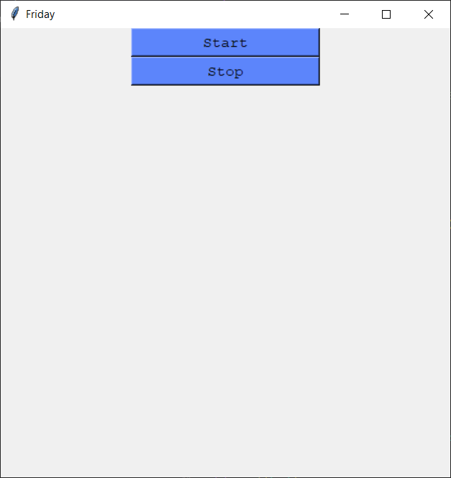

Slide 5
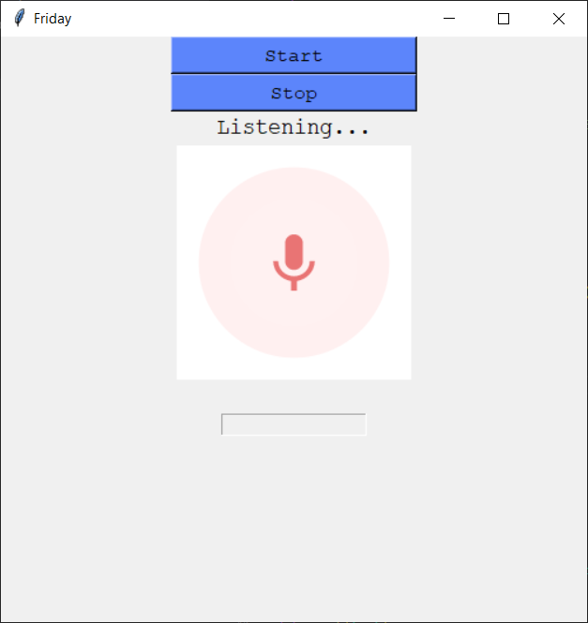

Slide 6
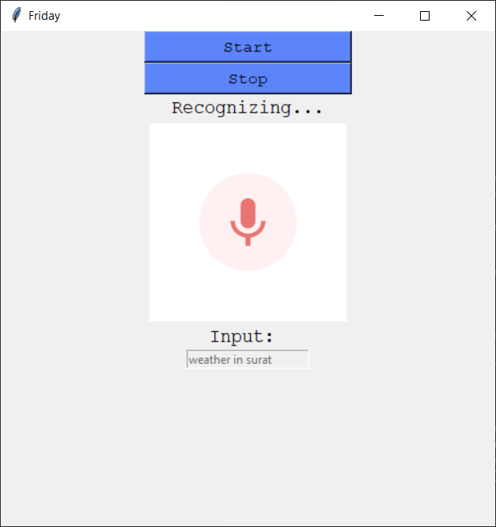

Slide 7


